Slide 1
Benjamin Abonneau – Alexis Payet – Rémi Goalard

Slide 2
Benjamin Abonneau – Alexis Payet – Rémi Goalard

Slide 3
Conlusion
Introduction to 6G
Apple : evolution to be an active technology motor
6G : a strategic opportunity for Apple

Slide 4
Introduction to 6G
Apple : evolution to be an active technology motor
Conlusion
6G : a strategic opportunity for Apple

Slide 5
Introduction to 6G
Apple : evolution to be an active technology motor
Conlusion
6G : a strategic opportunity for Apple

Slide 6
Introduction to 6G
Apple : evolution to be an active technology motor
6G : a strategic opportunity for Apple
Conlusion

Slide 7

Introduction to 6G

Slide 8

Introduction to 6G
What is 6G?
6th generation of cellular networks
Successor to 5G
Frequencies from 100 GHz to 3 THz
Significantly faster than previous generations
Systems are expected to be deployed by 2028
Expected to become available early in the 2030s

Slide 9
6G features
Ultra-low latency (0.1 milliseconds)
A focus on energy efficiency
Artificial intelligence and edge computing
machine-to-machine communication

Slide 10


Apple : evolution to be an active technology motor

Slide 11

Apple : evolution to be an active technology motor
Acquisition of P.A Semi => preparing their independence
Creation => computer sellers
Apple’s CPU release
1984
2019
1971
2008
2020
Macintoshe => computer using Motorola CPU
1B$ acquisition of Intel’s smartphone modem devision

Slide 12
Apple : evolution to be an active technology motor
Acquisition of P.A Semi => preparing their independence
Creation => computer sellers
Apple’s CPU release
1984
2019
1971
2008
2020
Macintoshe => computer using Motorola CPU
1B$ acquisition of Intel’s smartphone modem devision

Slide 13
6G : a strategic opportunity for Apple
6G : a strategic opportunity for Apple
6G : a strategic opportunity for Apple
6G : a strategic opportunity for Apple
6G : a strategic opportunity for Apple

Slide 14
6G : a strategic opportunity for Apple
6G : a strategic opportunity for Apple
6G : a strategic opportunity for Apple
6G : a strategic opportunity for Apple
6G : a strategic opportunity for Apple

Slide 15
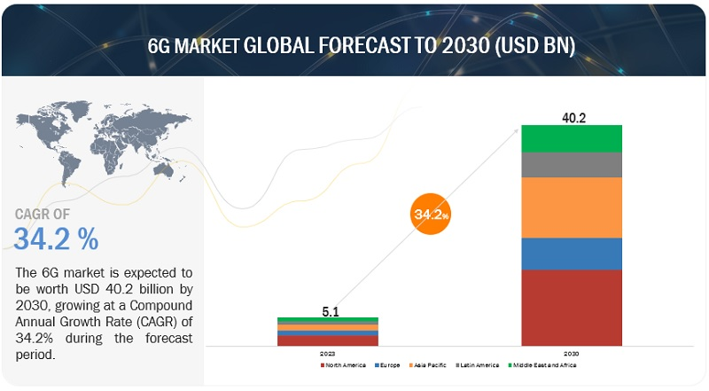
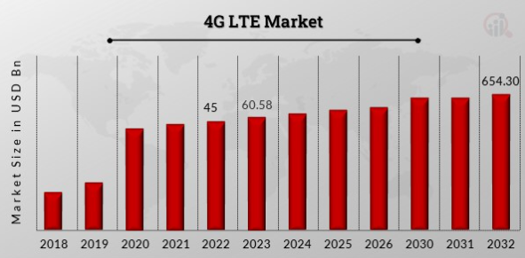
Very lucrative market

Slide 16
Very lucrative market

Slide 17
Everything to build

Slide 18
Everything to build
6G Hardware
Infrastructure

Slide 19

Everything to build
6G Hardware
Infrastructure

Slide 20

Everything to build
6G Hardware
Infrastructure

Slide 21
Apple's actual position

Slide 22
1 : No actual public declaration about their position on 6G
2 : Wireless technologies engineers recruitment
3 : "Next G alliance" (2019) => big tech society consortium

Slide 23


Slide 24

6G still in development => 2030
Big opportunity for companies :
Fast growing market
Open market (not taken)
Apple's preparation :
Own CPU
Next G Alliance
Recruitment
2030 still far => lot of opportunities

